Slide 1
Project presentation
Submitted to :
Ashfaq Ali Shafin
Lecturer
Dept. of CSE
Stamford University ,Bangladesh
Submitted by:
Group name :
( Creative Originality )
Tahmim Al Ashik CSE06307448
Sharmi Mondal CSE06307454
Nur – E – Alam CSE06307431

Slide 2
Proposed Project Pharmaceutical Company Intro and Product Management System

Slide 3
Some INFO BEFORE START
BANGLADESH HAVE ALMOST 1000+ PHARMACEUTICAL MEDICINE COMPNAY
97% MEDICINE OF LOCAL MARKET ARE SUPPLIED BY THEM
THIS SECTOR CAN BE ONE OF THE LARGEST FOREIGN MONEY INCOME SECTOR
MARKET VALUE OF THIS SECTOR IS AROUND 200 BILLION TAKA
[ACCORDING TO GOOGLE]

Slide 4
introduction
Pharmaceutical Company Intro and Product List management system is not like others drug house or pharmacy products management system tools. It will be created on the basis of a significant pharmaceutical company info and their product list . It will help a pharmaceutical company authority to show their product in details .If they want to give presentation about their product then it will help them a lot . Moreover this software will convert into mobile app with same feature so local user also get service from here.

Slide 5
objectives
Main objectives of this project are :
help a company to introduce themselves and their product .
local user can use this tools and get some info about product and referred doctor.
local peoples user facility will help companies advertisement

Slide 6
From the basis on objective UI demo:

Slide 7
General user will enter this system by clicking this section
X Pharmaceutical or
This section will use by the admin of this software for delete ,insert or update data
following registration and login form
General User
Admin

Slide 8
Opening interface of this UI will be showed by this section
All product of the company and details of them will show here by generic and name
Here referred doctor of the company ,their details and their comment will show
Company details , founder and employee info will show here
Home
About Us
Products
Doctors info
Upcoming products and their details will show here
Upcoming product

Slide 9
Hardware requirement
* Laptop or Pc
* Android Phone

Slide 10
Software requirement
Any version of windows Operating System
Java fx ,JDK and SQLite
Android studio and SQLite

Slide 11
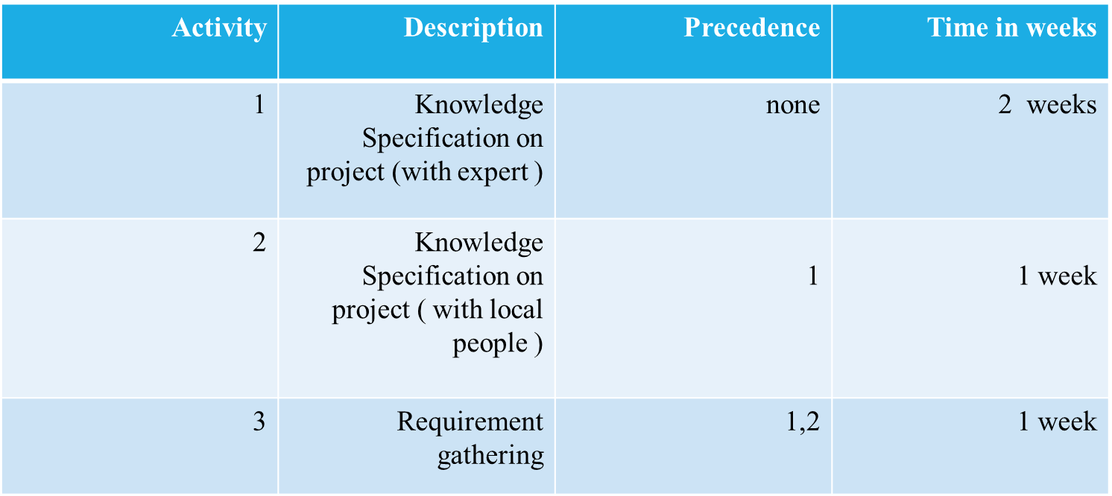
Project Scheduling
Analytical Steps :

Slide 12
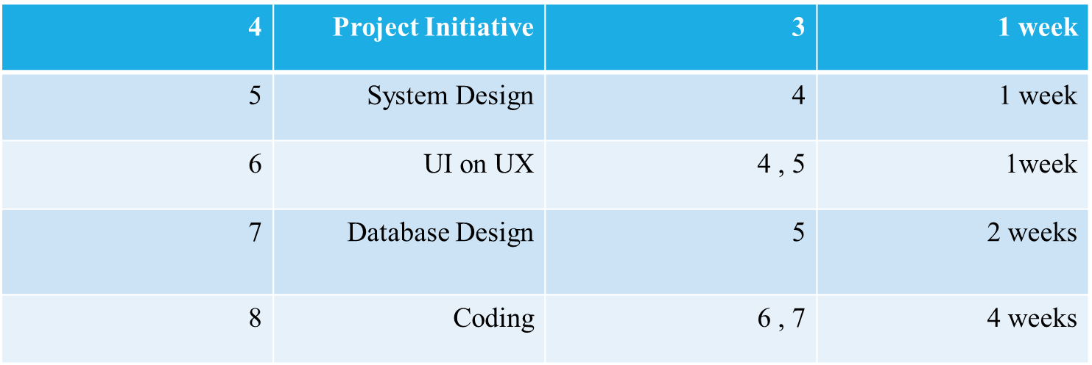
Project Scheduling
Planning and construction :

Slide 13
Project Scheduling
Deployment :
Activity | Description | Precedence | Time in weeks
9 | Testing | 6,7,8 | 2 weeks
10 | Releasing | 9 | 1 week

Slide 14
Our CONCERN
We will take 100 % liability if their will occur any bug at running software . We also give them initial support of training for controlling this software .

Slide 15
Thank you to all

